Slide 1
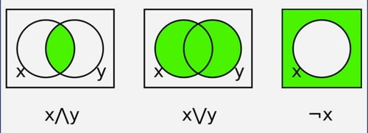
Boolean Algebra
Dr. Manju Khurana
Assistant Professor, CSED
TIET, Patiala
manju.khurana@thapar.edu

Slide 2
Boolean Algebra
2
Table of Contents
Introduction to Boolean Algebra
Standard Forms : SOP and POS
K-Maps : 2-variable, 3-variable, 4-variable

Slide 3
Boolean Algebra
3
Introduction
Boolean Algebra provides the operations and rules for working with the set {0, 1}. The three operations in Boolean Algebra that we will use most are Complementation, the Boolean sum and Boolean product.

Slide 4
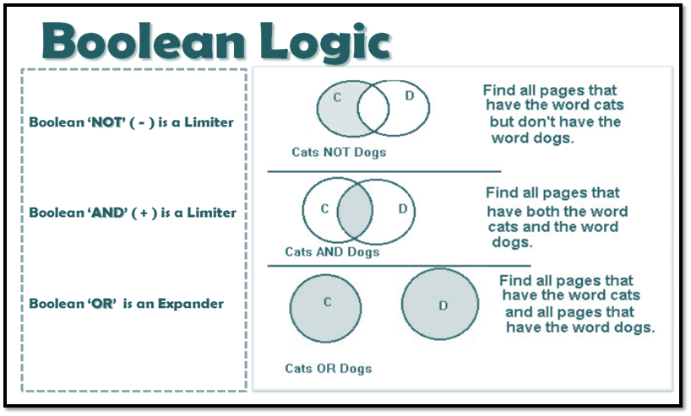
Boolean Algebra
4

Slide 5
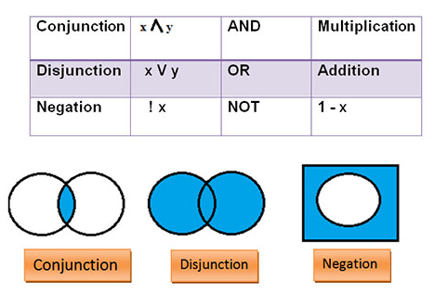
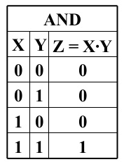
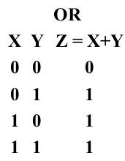
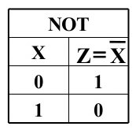
Boolean Algebra
5

Slide 6
Boolean Algebra
6
List of axioms and theorems:
Identity | A + 0 = A | A. 1 = A
Complement | A + A’ = 1 | A. A’ = 0
Commutative | A + B = B + A | A. B = B. A
Assosiative | A + (B + C) = (A + B) + C | A. (B. C) = (A. B). C
Distributive | A. (B + C) = A. B + A. C | A + (B. C) = (A + B). (A + C)
Null Element | A + 1 = 1 | A. 0 = 0
Involution | (A’)’ = A
Indempotency | A + A = A | A. A = A
Absorption | A + (A. B) = A | A. (A + B) = A
Distributive | A + A’. B = A + B | A’ + A.B = A’ + B
De Morgan’s | (A + B)’ = A’. B’ | (A. B)’ = A’. B’

Slide 7
Boolean Algebra
7
Example 1: Minimize the following expression by use of Boolean rules.
F = (A+B+C) (A+B’+C) (A+B+C’)
Let X = A+B
F = (X+C) (X+C’) (A+B’+C) Commutative Law
F = (X+CC’) (A+B’+C) Distributive Law
F = (X+0) (A+B’+C)
F = X. (A+B’+C)
F = (A+B) (A+B’+C)
F = A+B. (B’+C) Distributive Law
F = A+B.B’+BC
F = A+0+BC
F = A+BC

Slide 8
Boolean Algebra
8
Example 2: Minimize the following expression by use of Boolean rules.
G = (A+B) (A+B’) (A’+B) (A’+B’)
G = (A+BB’) (A’+BB’) Distributive Law
G = (A+0) (A’+0)
G = A.A’
G = 0

Slide 9


Slide 10
Boolean Algebra
Dr. Manju Khurana
Assistant Professor, CSED
TIET, Patiala
manju.khurana@thapar.edu

Slide 11
Boolean Algebra
11
Table of Contents
Introduction to Boolean Algebra
Standard Forms : SOP and POS
K-Maps : 2-variable, 3-variable, 4-variable

Slide 12
Boolean Algebra
12
Standard Forms
Canonical forms are basic forms obtained from the truth table of the function. These forms are usually not used to represent the function as they are cumbersome to write and it is preferable to represent the function in the least number of literals possible. There are two types of standard forms:
Sum of Products (SOP) A boolean expression involving AND terms with one or more literals each, OR’ed together.
Product of Sums (POS) A boolean expression involving OR terms with one or more literals each, AND’ed together.

Slide 13
Boolean Algebra
13
SOP (sum of products) | POS (product of sums)
A method of describing a Boolean expression using a set of min terms or product terms. | A method of describing a Boolean expression using a set of max terms or sum terms.
We write the product terms for each input combination that gives high (1) output. | We write the sum terms for each input combination that gives low (0) output.
We take the input variables if the value is 1 and write the complement of the variable if the value is 0 when writing the min terms. | We take the input variables if the value is 0 and write the complement of the variable if the value is 1 when writing the max terms.
Final expression is obtained by adding the relevant product terms. | Final expression is obtained by multiplying the relevant sum terms.

Slide 14
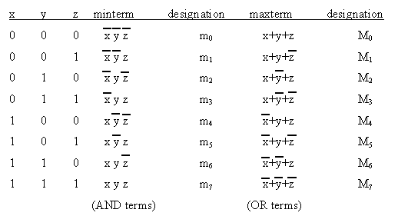
Boolean Algebra
14
Canonical Forms: Minterms and Maxterms

Slide 15
Boolean Algebra
15
For the given truth table, Minimize the SOP expression:
A | B | Y
0 | 0 | 0
0 | 1 | 1
1 | 0 | 0
1 | 1 | 1
Y = A’B + AB
Y = B (A + A‘)
Y = B

Slide 16

Boolean Algebra
16
Simplify the expression:
Y (A, B) = m(0, 2, 3)
Y = + +
Y = A’B’ + AB’ + AB
Y = B’ (A + A‘) + AB
Y = B’ + AB
Y = A + B’ Distributive Law
A | B | Y
0 | 0 | 1
0 | 1 | 0
1 | 0 | 1
1 | 1 | 1

Slide 17
Boolean Algebra
17
Simplify the expression:
A | B | C | F
0 | 0 | 0 | 0
0 | 0 | 1 | 0
0 | 1 | 0 | 1
0 | 1 | 1 | 0
1 | 0 | 0 | 1
1 | 0 | 1 | 1
1 | 1 | 0 | 1
1 | 1 | 1 | 1
F = A’BC’ + AB’C’ + AB’C + ABC’ + ABC
F = A’BC’ + AB’ (C + C’) + AB (C + C’)
F = A’BC’ + AB’ + AB
F = A’BC’ + A(B’ + B)
F = A’BC’ + A
F = BC’ + A Distributive Law
or
F = + + + +
or
F = m(2, 4, 5, 6, 7)

Slide 18
Boolean Algebra
18
For the given truth table, Minimize the POS expression:
A | B | Y
0 | 0 | 1
0 | 1 | 0
1 | 0 | 1
1 | 1 | 0
Y = (A+B’) . (A’+B’)
Y = B’+A A‘
Y = B’
or
Y = ( , )
or
Y = M (1, 3)

Slide 19
Boolean Algebra
19
Simplify the expression:
A | B | C | F
0 | 0 | 0 | 0
0 | 0 | 1 | 0
0 | 1 | 0 | 1
0 | 1 | 1 | 0
1 | 0 | 0 | 1
1 | 0 | 1 | 1
1 | 1 | 0 | 1
1 | 1 | 1 | 1
F = (A + B + C).(A + B + C’).(A + B’ + C’)
F = (A + B + CC’).(A + B’ + C’)
F = (A + B).(A + B’ + C’)
F = A + B.(B’ + C’)
F = A + B B’+ BC’
F = A + BC‘
F = (A + B) (A + C‘)

Slide 21
Boolean Algebra
Dr. Manju Khurana
Assistant Professor, CSED
TIET, Patiala
manju.khurana@thapar.edu

Slide 22
Boolean Algebra
22
Table of Contents
Introduction to Boolean Algebra
Standard Forms : SOP and POS
K-Maps : 2-variable, 3-variable, 4-variable

Slide 23
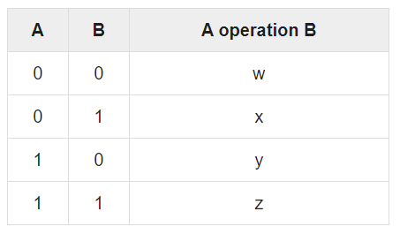
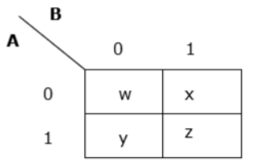
Boolean Algebra
23
K-Maps
The Karnaugh map (K-map) is a method of simplifying Boolean algebra expressions.
Example 1
An arbitrary truth table is taken below
Now we will make a k-map for the above truth table

Slide 24
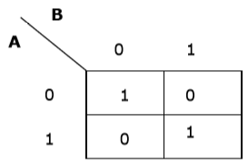
Boolean Algebra
24
K-Maps
Example 2
Now we will make a K-map for the expression: A’B’ + AB

Slide 25
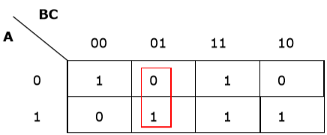
Boolean Algebra
25
Simplification Using K-map
K-map uses some rules for the simplification of Boolean expressions by combining together adjacent cells into single term. The rules are described below −
Rule 1 − Any cell containing a zero cannot be grouped.
Wrong grouping

Slide 26
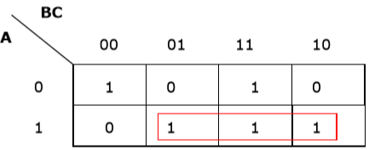
Boolean Algebra
26
Rule 2 − Groups must contain 2^{n} cells (n starting from 1).
Wrong grouping

Slide 27
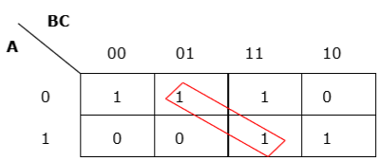
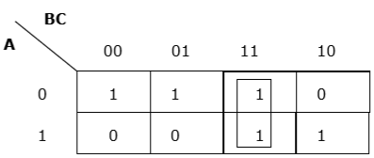
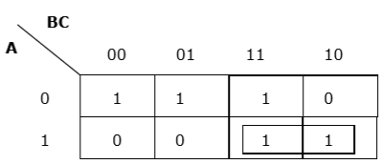
Boolean Algebra
27
Rule 3 − Grouping must be horizontal or vertical, but must not be diagonal.
Wrong diagonal grouping
Proper vertical grouping
Proper horizontal grouping

Slide 28
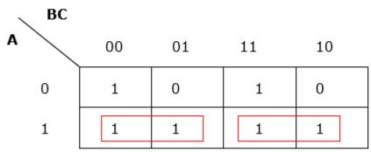
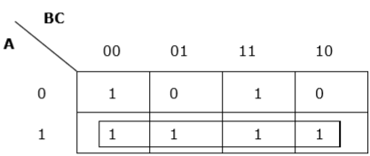
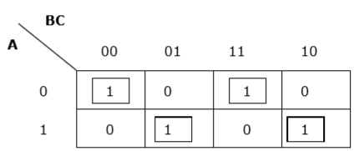
Boolean Algebra
28
Rule 4 − Groups must be covered as largely as possible.
Insufficient grouping
Proper grouping
Rule 5 − If 1 of any cell cannot be grouped with any other cell, it will act as a group itself.
Proper grouping

Slide 29
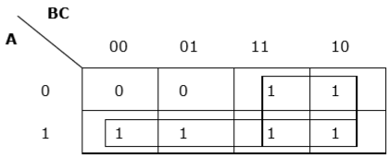
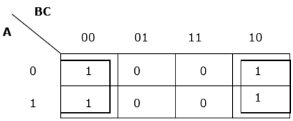
Boolean Algebra
29
Rule 6 − Groups may overlap but there should be as few groups as possible.
Proper grouping
Rule 7 − The leftmost cell/cells can be grouped with the rightmost cell/cells and the topmost cell/cells can be grouped with the bottommost cell/cells.
Proper grouping

Slide 30
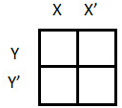
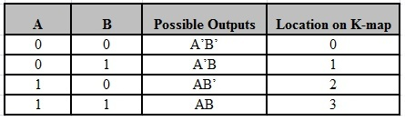
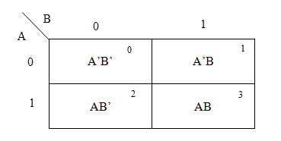
Boolean Algebra
30
2 variable K-maps
There are 4 cells in the 2-variable k-map. It will look like:
The following table shows the positions of all the possible outputs of 2-variable Boolean function on a K-map.
A general representation of a 2 variable K-map plot is shown below.

Slide 31
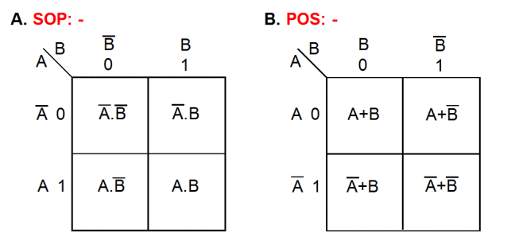
Boolean Algebra
31
2 variable K-maps

Slide 32
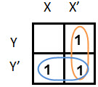
Boolean Algebra
32
Simplify the given 2-variable Boolean equation by using K-map.
F = X Y’ + X’ Y + X’Y’
First, let’s construct the truth table for the given equation,
X | Y | F
0 | 0 | 1
0 | 1 | 1
1 | 0 | 1
1 | 1 | 0
We put 1 at the output terms given in equation.
After grouping the variables, the next step is determining the minimized expression.
So the reduced equation will be X’ + Y’.

Slide 33
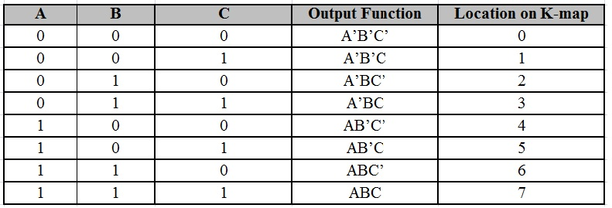
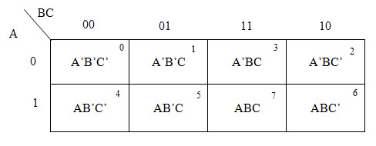
Boolean Algebra
33
3 variable K-maps
For a 3-variable Boolean function, there is a possibility of 8 output min terms. The general representation of all the min terms using 3-variables is shown below:
A typical plot of a 3-variable K-map is shown below. It can be observed that the positions of columns 10 and 11 are interchanged so that there is only change in one variable across adjacent cells. This modification will allow in minimizing the logic.

Slide 34
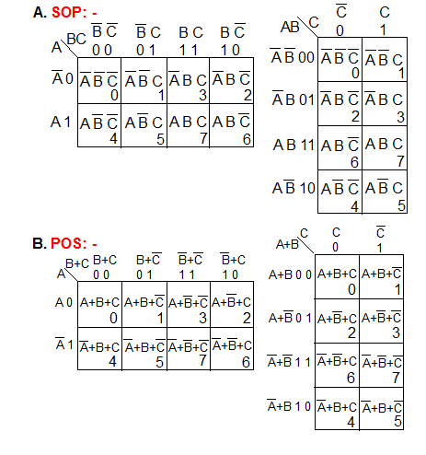
Boolean Algebra
34
3 variable K-maps

Slide 35
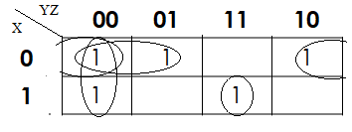
Boolean Algebra
35
Simplify the given 3-variable Boolean equation by using K-map.
F = X’ Y’ Z’ + X’ Y’ Z + X’ Y Z’ + X Y’ Z’ + X Y Z
X | Y | Z | F
0 | 0 | 0 | 1
0 | 0 | 1 | 1
0 | 1 | 0 | 1
0 | 1 | 1 | 0
1 | 0 | 0 | 1
1 | 0 | 1 | 0
1 | 1 | 0 | 0
1 | 1 | 1 | 1
First, let’s construct the truth table for the given equation,
We put 1 at the output terms given in equation.
After grouping the variables, the next step is determining the minimized expression.
So the reduced equation will be X Y Z + X’ Z’ + X’ Y’ + Y’ Z’.

Slide 36
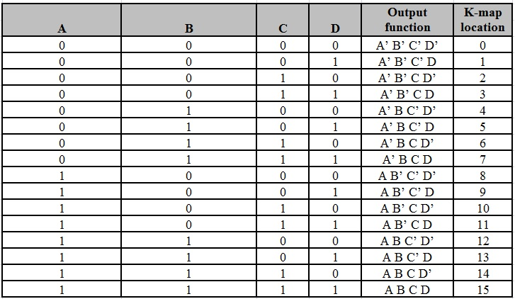
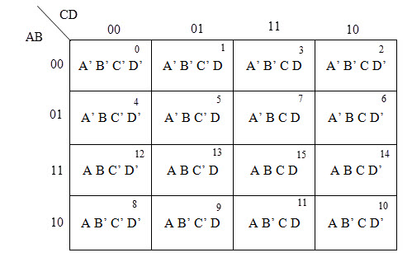
Boolean Algebra
36
4 variable K-maps
There are 16 possible min terms in case of a 4-variable Boolean function. The general representation of minterms using 4 variables is shown below:
A typical 4-variable K-map plot is shown below. It can be observed that both the columns and rows of 10 and 11 are interchanged.

Slide 37
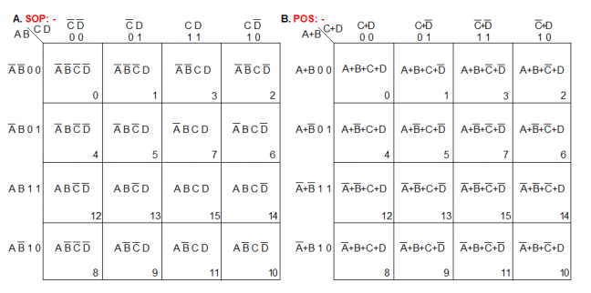
Boolean Algebra
37
4 variable K-maps

Slide 38
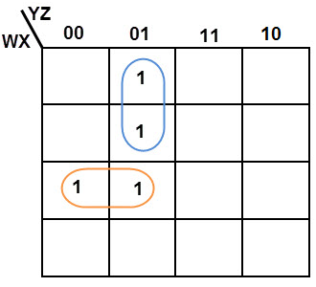
Boolean Algebra
38
Simplify the given 4-variable Boolean equation by using K-map.
F (W, X, Y, Z) = (1, 5, 12, 13)
By preparing k-map, we can minimize the given Boolean equation as
So the reduced equation will be F = W X Y’ + W ‘Y’ Z.

